Slide 1
Tragic Figure
The Crucible
American Literature

Slide 2
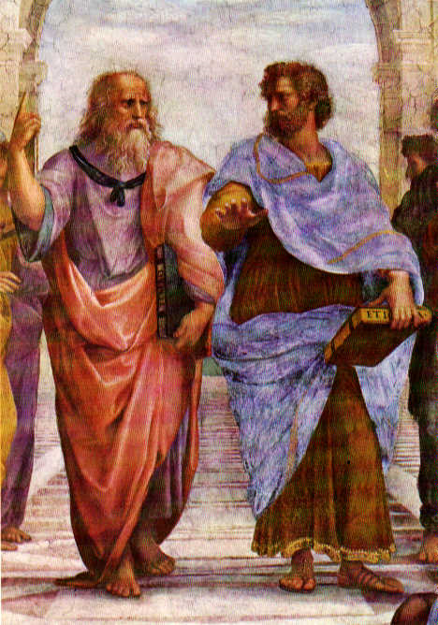
Meet Aristotle
Greek philosopher
Wrote Poetics
Influenced Shakespeare and numerous other writers through his definition of tragedy

Slide 3
From Poetics
Tragedy is
“an imitation of an action that is serious, complete, and of a certain magnitude”
embellished language
“in the form of action, not of narrative”
Focus on plot
“with incidents arousing pity and fear, [with the purpose of accomplishing] katharsis of such emotions
Katharsis= purging or cleansing of emotion
…when it feels good to cry…

Slide 4
Elements of a tragic figure
Nobility
Hero falls from a “great height”
Noble character
Flaw
Some “error or frailty”
Character is not perfect!
Helps us to identify with the character…

Slide 5
Elements of a tragic figure (continued)
Reversal of fortune
“Action turns around to its opposite”
Recognition
Change from ignorance to knowledge
Downfall
Character is utterly ruined

